Slide 1
Machine Learning Approaches for Predicting Composition-Property Relationship in Industrial Steels
Vekilov Bankers [G-0021]
Saikiran Anugam, Department of Engineering Data science
Hariharan Annadurai, Department of Chemical and Biomolecular Engineering

Slide 2
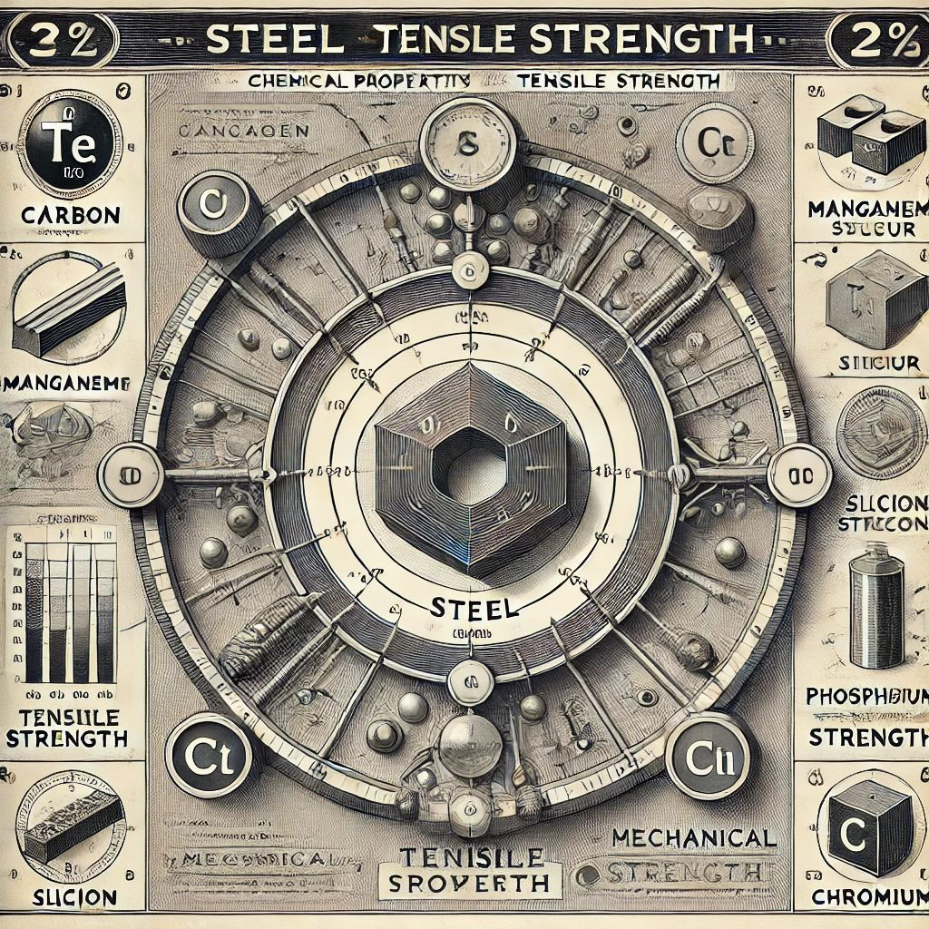
Background
Steel is a versatile and widely used material known for its strength, durability, and adaptability. It is primarily composed of iron and carbon, with properties that can be significantly altered by adjusting the carbon content and adding various alloying elements such as manganese, chromium, nickel, and titanium.
Steel is broadly classified based on composition and use, including low, medium, and high carbon steel, as well as alloy steels like stainless steel and tool steel.
Understanding mechanical properties like tensile strength, yield strength, and elongation is crucial for steel's applications. By optimizing chemical composition and processing methods, engineers can design steels with tailored properties for specific uses, ensuring safety, efficiency, and longevity.
Fig.1 Chemical Properties and Tensile Strength

Slide 3
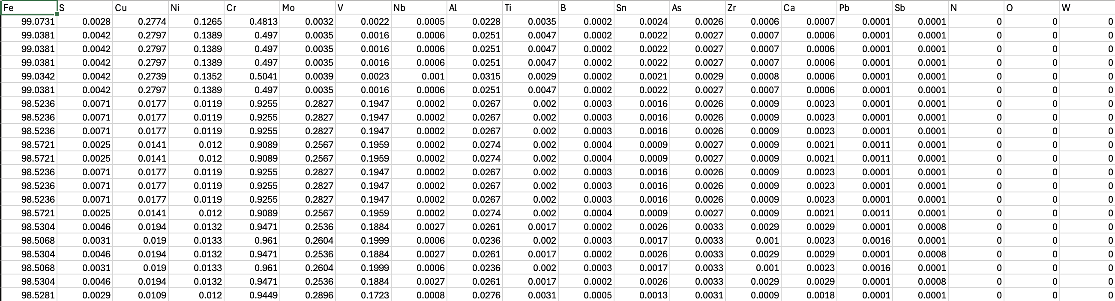
Dataset
The dataset consists of 63,162 rows and 23 columns, representing various chemical elements and mechanical properties of steel. Additionally, the dataset includes mechanical properties like Yield Strength (YS), Tensile Strength (TS), and Elongation (EL).
The summary statistics reveal several important insights. Iron (Fe) has a mean of 99.818 with a very low standard deviation, indicating it is the primary component in all samples. In contrast, elements such as Sulfur (S), Copper (Cu), Nickel (Ni), and other alloying elements have much lower means and higher relative standard deviations, reflecting their role as alloying elements present in varying amounts. The mechanical properties, Yield Strength (YS) and Tensile Strength (TS), show substantial variability, with mean values of 365.8 and 455.8, respectively. Elongation (EL) ranges from 4.5 to 99, with a mean of 37.33, indicating a wide range of ductility in the samples.
63,162 rows

Slide 4
Feature Selection: Methods
Methods
Pearson correlation
Mutual information
Recursive Feature Elimination
Univariate
Selecting the subset of the relevant features for model construction
Crucial step in preprocessing data in machine learning and statistical modelling
Improve model performance: Removing redundant information can help the predictive performance of the model
Removes over fitting: Selecting important features – less likely to learn from the noise and generalizes the unseen data

Slide 5
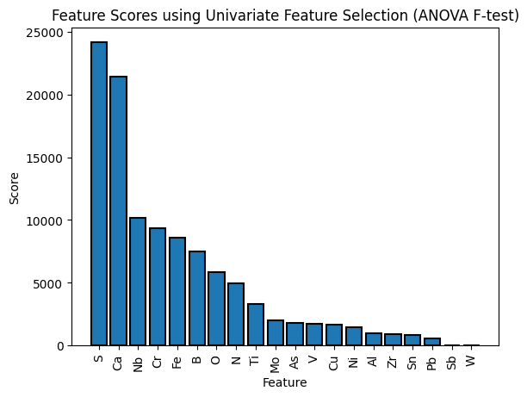
1. Univariate Feature Selection (ANOVA F-test)
It evaluates each feature individually to determine its relationship with the target:
We used the SelectKBest method from sklearn feature selection to apply the ANOVA F-test, which compares the variance between chemical composition and tensile strength
Features were ranked based on their F-scores, and the results were visualized in Fig.2 to identify the most significant predictors
S (Sulphur), Ca (Calcium), and Nb (Niobium) are the most significant predictors of tensile strength
Elements like W (Tungsten) and Sb (Antimony) have much lower F-scores, indicating a lesser impact on tensile strength
Fig.2 Feature Selection using ANOVA F-test

Slide 6
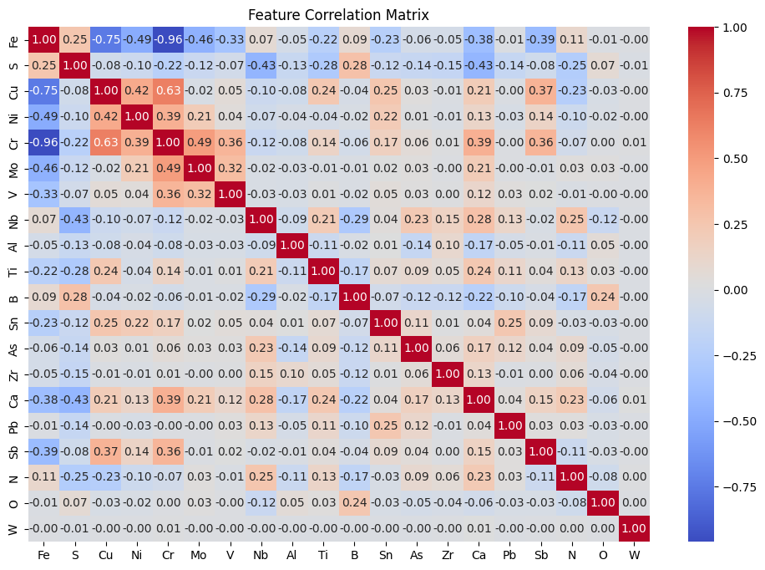
2. Pearson Correlation Coefficient
To understand the relationships between different features in the dataset we calculated their pairwise correlations using Pearson Correlation function
Fig.2 heatmap provides a visual representation where darker colors indicate stronger correlations (either positive or negative)
Features like Fe and Cr have a strong negative correlation (-0.96), indicating that as the concentration of Fe increases, the concentration of Cr decreases
Similarly, S and Ca have a strong negative correlation (-0.86)
Ti and Zr have a strong positive correlation (0.80), suggesting that these elements tend to increase together
Identifying highly correlated features allows for more informed decisions on feature selection and understanding multicollinearity, potentially improving model accuracy and stability
Fig.3 Heatmap visualizing Correlation Matrix

Slide 7
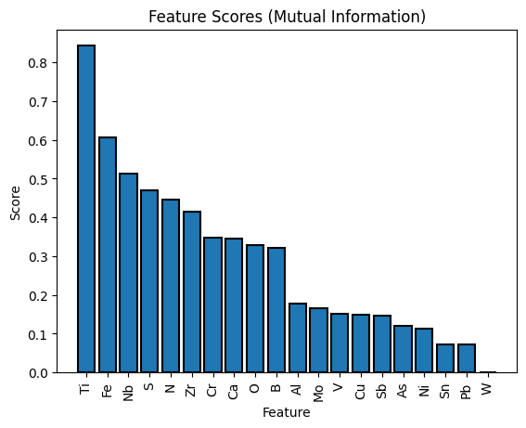
3. Mutual Information
Measures the dependency between two variables. It quantifies how much information about one variable can be obtained by knowing the other variable.
MI can detect non-linear dependencies between features and the target variable, which traditional linear correlation methods might miss.
We used SelectKBest with mutual_info_regression as the scoring function to evaluate the relevance of each feature.
Top Features:
Ti (Titanium): Highest MI score (0.84), indicating it has the most significant impact on Tensile Strength.
Fe (Iron): Second highest MI score (0.61), suggesting a strong relationship with the target variable.
Nb (Niobium): Also shows a high MI score (0.51), indicating its importance.
Less Influential Features:
Sn (Tin): Low MI score (0.07), suggesting it has a minimal impact on the target variable.
W (Tungsten): MI score of 0, indicating no dependency with the target variable.
Fig.4 Feature Scores using Mutual Information

Slide 8
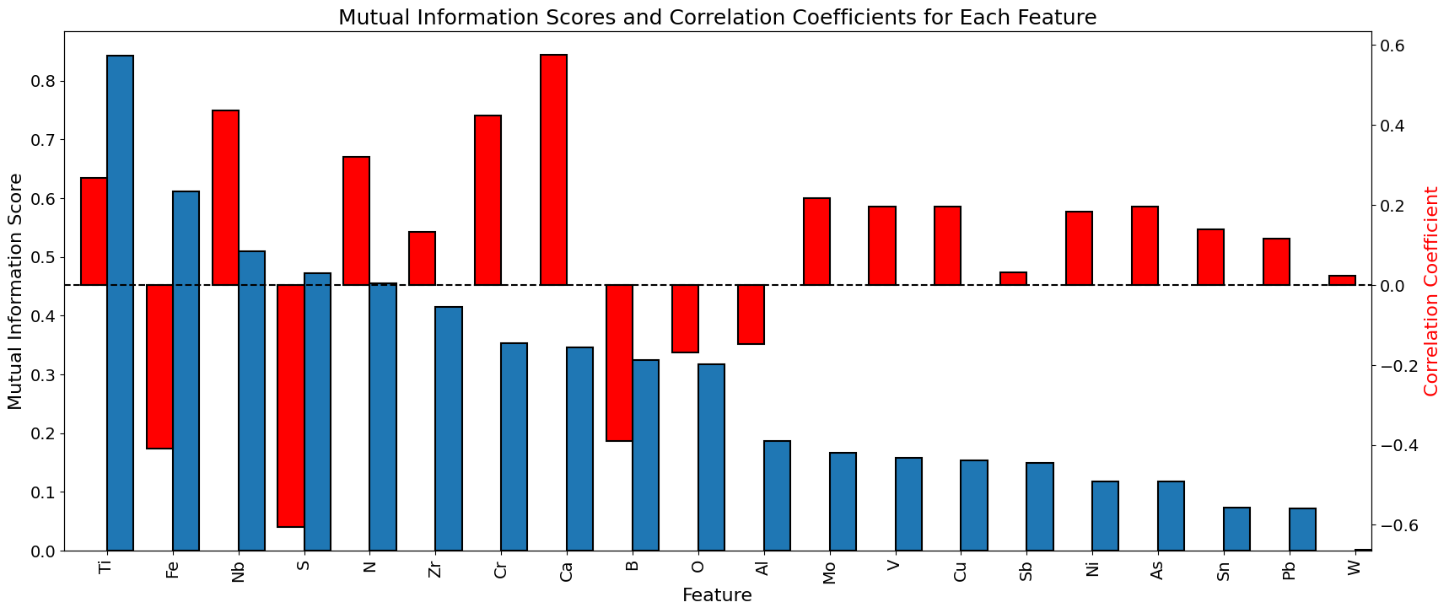
Comparison: Mutual Information Scores and Correlation Coefficients
Fig.5 Relation between Mutual Information and Correlation
Key Insights:
Ti (Titanium):
High mutual information score (0.84) and moderate positive correlation (0.63), indicating it is both informative and positively correlated with TS.
Fe (Iron):
High mutual information score (0.61) and negative correlation (-0.49), indicating it is informative but inversely related to TS.
Cr (Chromium) and S (Sulfur):
Moderate mutual information scores and correlation coefficients, showing their relevance in predicting TS.

Slide 9
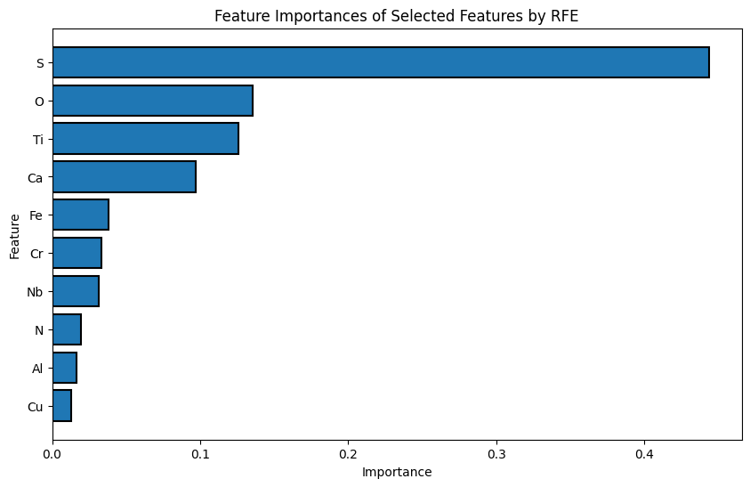
4.Recursive Feature Elimination using Random Forest Regressor
RFE is a feature selection method that fits a model and removes the weakest features until the specified number of features is reached.
It recursively considers smaller and smaller sets of features to identify the most relevant features for the predictive model.
RFE helps in identifying the most relevant features based on their importance scores derived from Random Forest Regressor.
Top Features:
S (Sulfur): Highest importance score, indicating it has the most significant impact on Tensile Strength.
O (Oxygen) and Ti (Titanium): Also show high importance scores, suggesting strong relevance.
Less Influential Features:
Cu (Copper) and Al (Aluminum): Lower importance scores, indicating less impact on the target variable compared to other selected features.
Fig.6 Feature Importances using Random Forest Regressor

Slide 10
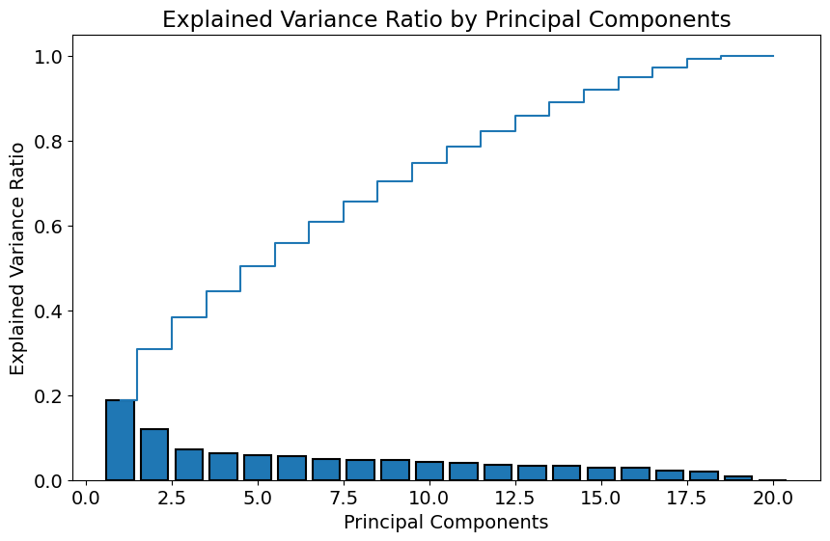
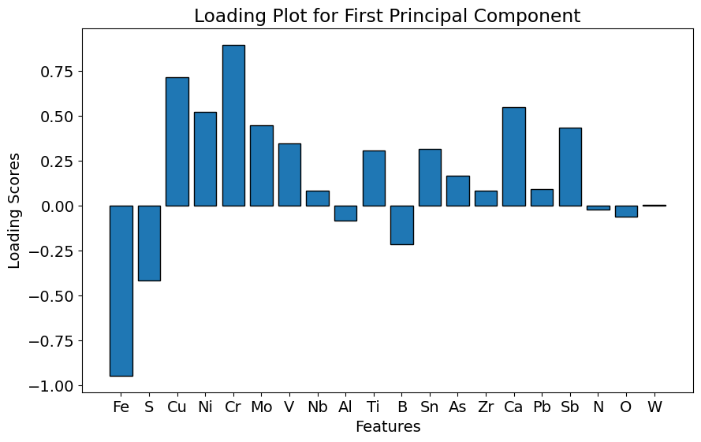
5.Dimensionality Reduction using Principal Component Analysis
PCA is a dimensionality reduction technique that transforms the original features into a new set of orthogonal features called principal components.
In this case, 12 principal components explain around 80% of the variance, indicating that a significant reduction in dimensionality can be achieved while retaining most of the information.
The bar plot shows the individual explained variance for each principal component, step plot shows the cumulative explained variance.
The magnitude of the loading scores indicates the strength of the contribution. Larger magnitudes (positive or negative) indicate stronger contributions.
Fig.7 Explained Variance vs Principal Components
Fig.8 Loading Plot for First Principal Component
Notes:
Analysis of the Plot:
Strong Positive Contributors:
Cr (Chromium): Highest positive loading score, indicating a strong positive contribution to the first principal component.
Ni (Nickel) and Mo (Molybdenum): Also have high positive loading scores.
Strong Negative Contributors:
Fe (Iron): Highest negative loading score, indicating a strong negative contribution to the first principal component.
S (Sulfur): Also has a significant negative loading score.
Moderate Contributors:
Ca (Calcium) and Pb (Lead): Moderate positive loading scores, contributing positively but not as strongly as Cr or Ni.
Nb (Niobium) and Al (Aluminum): Moderate negative loading scores.

Slide 11
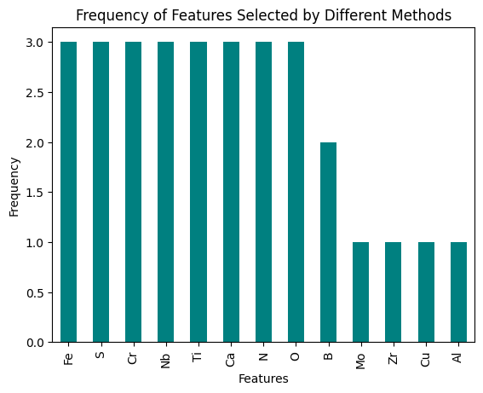
Frequency of Features Selected by Different Methods
1. Correlation-based Selection:
Selected features: ['Fe', 'S', 'Cr', 'Mo', 'Nb', 'Ti', 'B', 'Ca', 'N', 'O’].
2. Mutual Information (MI):
Selected features: ['Ti', 'Fe', 'Nb', 'S', 'N', 'Zr', 'Cr', 'Ca', 'O', 'B’].
3. Recursive Feature Elimination (RFE):
Selected features: ['Fe', 'S', 'Cu', 'Cr', 'Nb', 'Al', 'Ti', 'Ca', 'N', 'O'].
Fig.9 Frequencies of Features

Slide 12
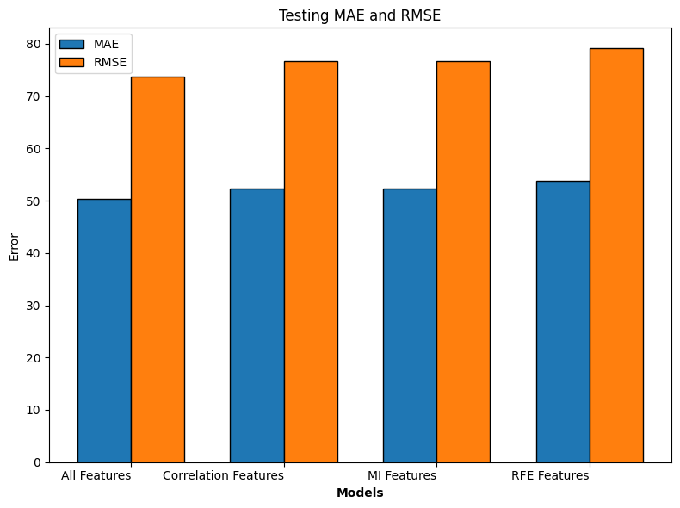
Models
Linear Regression Model | MAE | RMSE
Linear Regression with All Features | 50.41 | 73.67
Correlation Feature Selection | 52.35 | 76.70
MI Feature Selection | 52.29 | 76.67
RFE using Random Forest Regressor | 53.85 | 79.09
1.Linear Regression
Using all features provides the best performance across all metrics (MAE, RMSE) for the linear regression model.
Feature Selection Insight:
While feature selection methods like correlation and MI slightly degrade performance, they can still be useful for model interpretability and dimensionality reduction.
RFE shows the least performance improvement, indicating it may not be the best choice for this specific model and dataset.
Table1. MAE, RMSE using Linear Regression

Slide 13
KNN Regression
We found the best hyperparameters for the K-Nearest Neighbors (KNN) regressor using Grid Search Cross-Validation (CV)
Hyperparameters:
n_neighbors:
The number of nearest neighbors to consider for making the prediction.
Values tested: [3, 5, 7, 9]
weights:
The weight function used in prediction
Options: ['uniform', 'distance']
uniform: All neighbors are weighted equally
distance: Closer neighbors have a greater influence on the prediction
metric:
The distance metric used to find the nearest neighbors
Options: ['euclidean', 'manhattan', 'minkowski']
euclidean: Standard Euclidean distance
manhattan: Sum of absolute differences
minkowski: Generalization of Euclidean and Manhattan distances
Best Hyperparameters
metric: 'manhattan',n_neighbors: 9,weights: 'distance'
KNN Regression Model | MAE | RMSE
KNN Regressor with All Features | 17.57 | 27.13
Correlation Feature Selection | 17.54 | 26.95
MI Feature Selection | 17.57 | 27.02
RFE using Random Forest Regressor | 17.77 | 27.50
PCA | 25.46 | 47.52
Table2. MAE, RMSE using KNN Regression

Slide 14
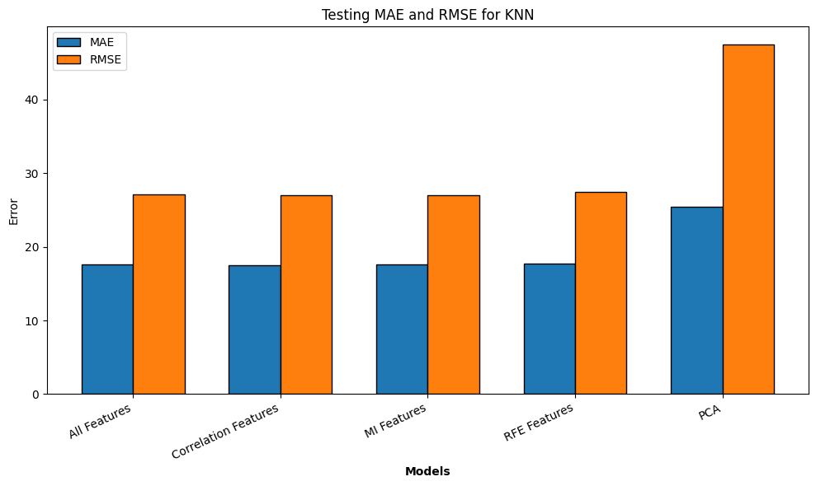
KNN Regression
PCA Performance:
PCA demonstrates the least effective performance across all metrics (MAE, MSE, RMSE) for the KNN Regressor model
Feature Selection Insight:
Correlation and MI feature selection methods provide the best performance, producing similar and slightly better results compared to using all features
RFE performs slightly worse than other feature selection methods but better than PCA
In this case, correlation and MI feature selection methods are recommended for the KNN Regressor model

Slide 15
Random Forest
Random Forest is an ensemble learning method that constructs multiple decision trees and merges them to obtain more accurate and stable predictions.
Hyperparameters:
Number of estimators:
The number of trees in the forest.
Values tested: [100, 200]
max_depth:
The maximum depth of each tree.
Values tested: [None, 10, 20]
None: Nodes are expanded until all leaves are pure or until all leaves contain less than min_samples_split samples.
min_samples_split:
The minimum number of samples required to split an internal node.
Values tested: [2, 5, 10]
min_samples_leaf:
The minimum number of samples required to be at a leaf node.
Values tested: [1, 2, 4]
Best hyperparameters found during the randomized search are: n_estimators':200, min_samples_split: 5, min_samples_leaf: 1, max_depth: None
Random Forest Model | Feature Selection Method | MAE | Testing RMSE
Random Forest Regressor | All Features | 16.93 | 25.59
 | Correlation Features | 17.10 | 25.87
 | MI Features | 17.01 | 25.71
 | RFE Features | 17.19 | 25.95
 | PCA | 33.86 | 56.39
Table3. MAE, RMSE using Random Forest

Slide 16
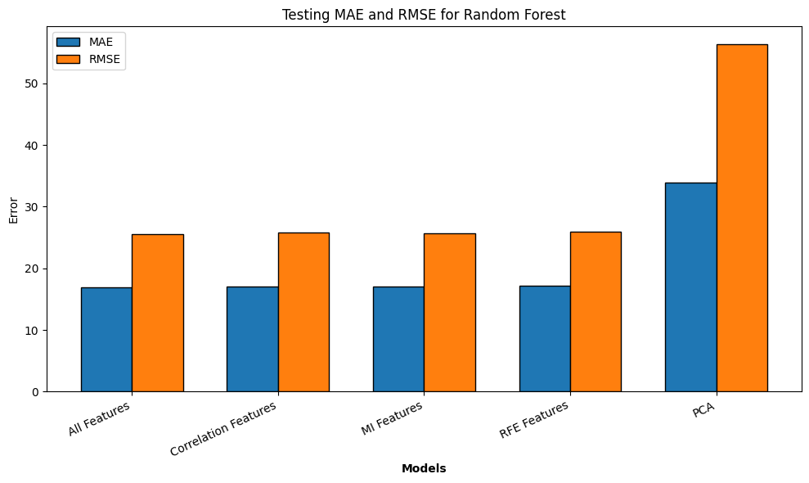
All Features Performance:
Using all features provides the best performance across all metrics (MAE, MSE, RMSE) for the Random Forest Regressor model.
Feature Selection Insight:
Correlation, MI, and RFE feature selection methods provide reasonable performance, with MI slightly better among them.
PCA demonstrates the least effective performance across all metrics, indicating it may not be suitable for this model and dataset.

Slide 17
Support Vector Regressor
SVR is a type of Support Vector Machine (SVM) that is used for regression tasks. It finds a hyperplane that best fits the data by minimizing the error within a certain margin (epsilon).
Hyperparameters:
C:
The regularization parameter. It controls the trade-off between achieving a low error on the training data and minimizing the model complexity.
Values tested: [0.1, 1, 10, 100]
epsilon:
The epsilon parameter in the epsilon-SVR model. It specifies the epsilon-tube within which no penalty is associated with the training loss function.
Values tested: [0.01, 0.1, 0.5, 1]
gamma:
The kernel coefficient for ‘rbf’, ‘poly’, and ‘sigmoid’.
Values tested: ['scale', 'auto', 0.001, 0.01, 0.1]
kernel:
Specifies the kernel type to be used in the algorithm.
Options: ['linear', 'poly', 'rbf', 'sigmoid']
The best hyperparameters for the SVR model using Grid search were found to be using the RBF kernel with C of 100, epsilon of 1, and gamma set to 'scale'
SVR Model | MAE | RMSE
SVR with All Features | 27.43 | 44.32
SVR with Correlation Feature Selection | 27.32 | 43.54
SVR with MI Feature Selection | 26.96 | 43.00
PCA with 80% Variance | 31.41 | 50.43
SVR with RFE using RandomForestRegressor | 28.75 | 44.80
Table4. MAE, RMSE using Support Vector Regressor

Slide 18
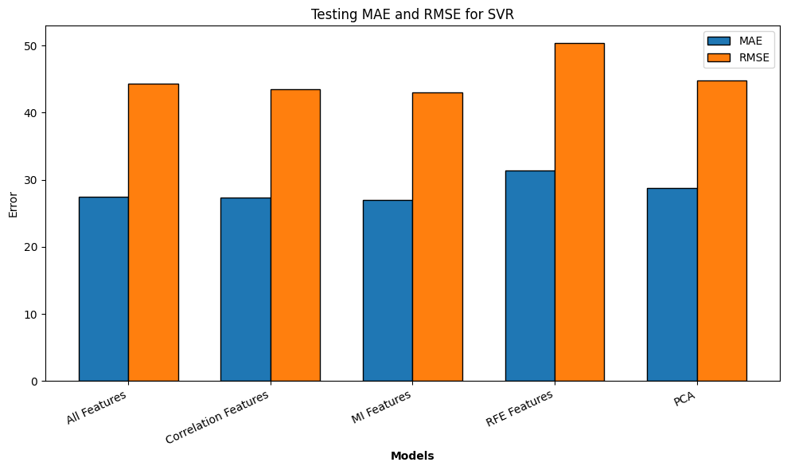
MI Feature Selection Performance:
Using MI feature selection provides the best performance across all metrics (MAE, MSE, RMSE) for the SVR model.
Feature Selection Insight:
Correlation and MI feature selection methods provide reasonable performance, with MI being the best among them.
PCA demonstrates the least effective performance across all metrics, indicating it may not be suitable for this model and dataset.
In this case, MI feature selection is recommended for the SVR model.

Slide 19
All Model Comparison: MAE, RMSE
Model | Feature Selection Method | Testing MAE | Testing RMSE
SVR | All Features | 27.43 | 44.32
SVR | Correlation Features | 27.32 | 43.54
SVR | MI Features | 26.96 | 43.00
SVR | RFE Features | 28.75 | 44.80
SVR | PCA | 31.41 | 50.43
KNN Regressor | All Features | 17.57 | 27.13
KNN Regressor | Correlation Features | 17.54 | 26.95
KNN Regressor | MI Features | 17.57 | 27.02
KNN Regressor | RFE Features | 17.77 | 27.50
KNN Regressor | PCA | 25.46 | 47.52
Random Forest | All Features | 16.93 | 25.59
Random Forest | Correlation Features | 17.10 | 25.87
Random Forest | MI Features | 17.01 | 25.71
Random Forest | RFE Features | 17.19 | 25.95
Random Forest | PCA | 33.86 | 56.39
Linear Regression | All Features | 50.41 | 73.67
Linear Regression | Correlation Features | 52.35 | 76.70
Linear Regression | MI Features | 52.29 | 76.67
Linear Regression | RFE Features | 53.85 | 79.09

Slide 20
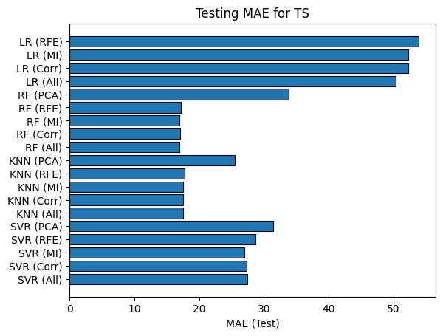
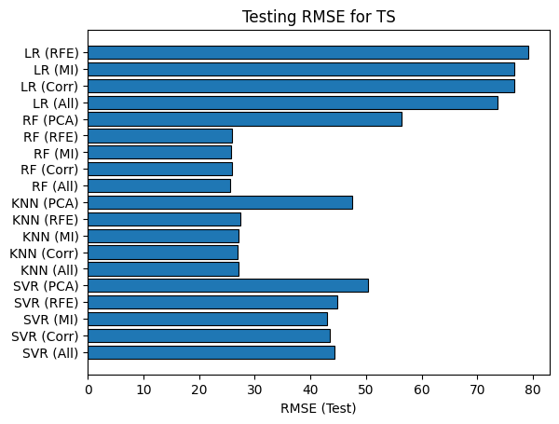
All Model Comparison: MAE, RMSE

Slide 21
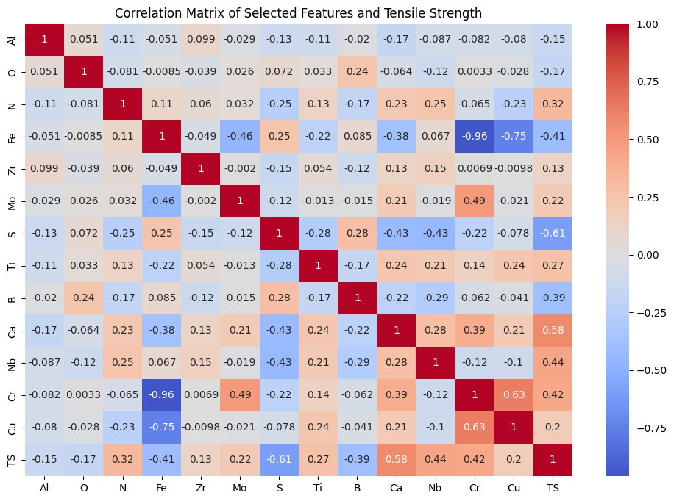
Correlation Matrix of Most Frequent Features and Tensile Strength
Positive Correlations: Elements like calcium, niobium, and titanium, known for their roles in improving tensile strength through various mechanisms, show positive correlations.
Negative Correlations: Elements like sulfur, which are known to be detrimental to mechanical properties, show expected negative correlations.

Slide 22
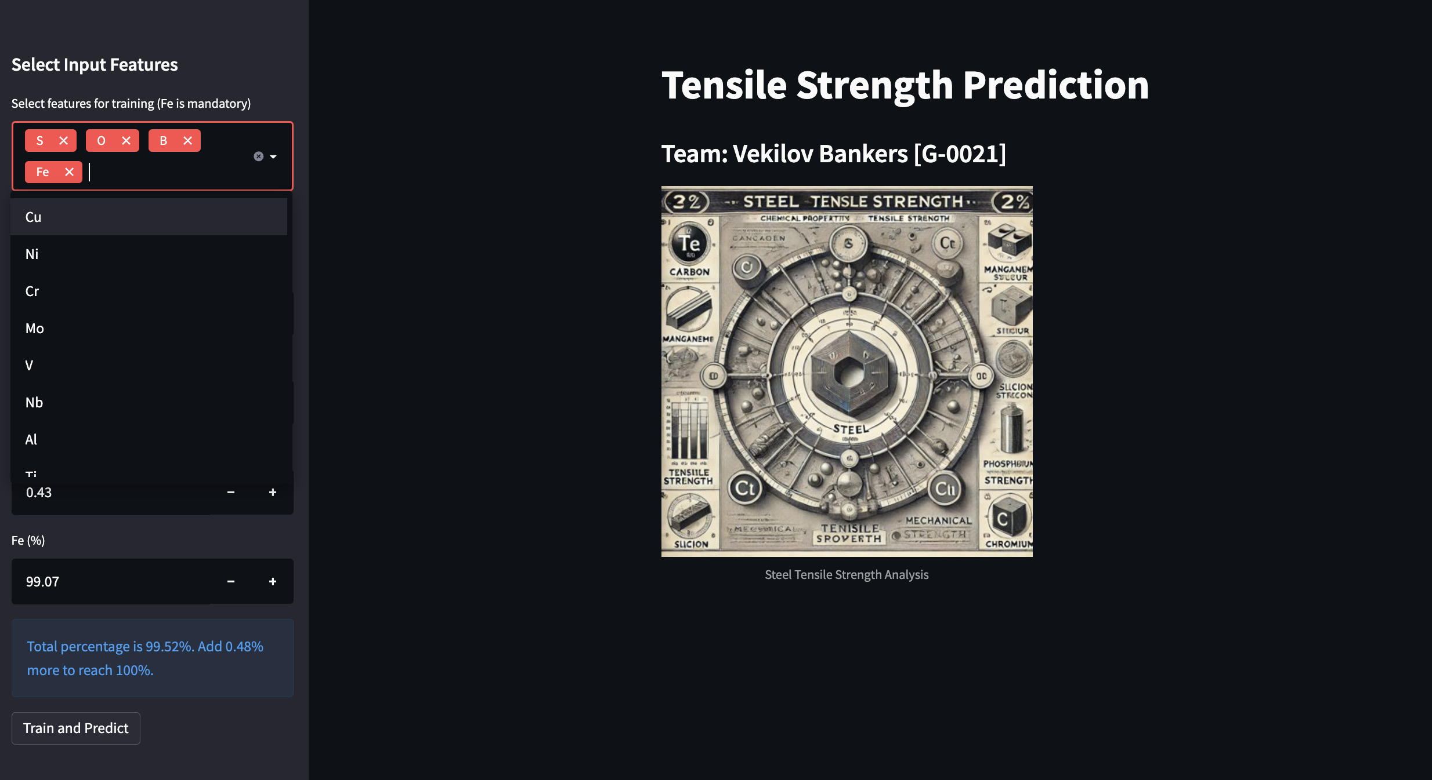

Slide 23


Slide 24
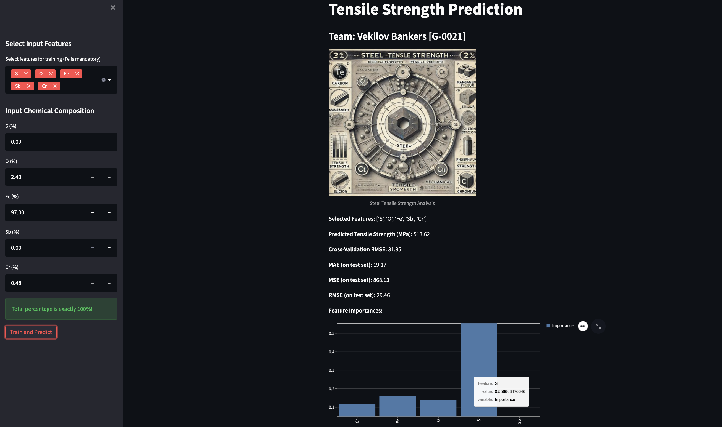

Slide 25
Conclusion
This analysis highlights the key chemical elements influencing the tensile strength of industrial steels. Using feature selection techniques and machine learning models, we found that the Random Forest model with features selected through Mutual Information (MI) provides the most accurate predictions. Incorporating common features from all methods enhances model robustness and accuracy. Notably, titanium improves tensile strength by controlling microstructure and forming precipitates with carbon and nitrogen. The prevalence of transition metals and sulfur's role, traditionally for deoxidation, is particularly interesting. Our findings align well with metallurgical principles, validating the importance of elements like titanium, chromium, and niobium in enhancing mechanical properties through mechanisms such as grain size control and precipitation hardening. This alignment further supports our findings' applicability in steel production and improvement.

Slide 26
Future Work
This study can be extended to analyze other mechanical properties of steel, such as yield strength and elongation.
By applying similar feature selection techniques and machine learning models, we can identify the important chemical elements influencing these properties.
Comparing the important features across tensile strength, yield strength, and elongation will provide a comprehensive understanding of the chemical influences on the mechanical properties of steel.
Additionally, analyzing the stress-strain ratio will offer deeper insights into the material's behavior under stress, further aiding in the development of high-performance steels.

Slide 27
References
Guo, S., Yu, J., Liu, X., Wang, C., & Jiang, Q. (2019). A predicting model for properties of steel using the industrial big data based on machine learning. Computational Materials Science, 160, 95–104.
⁠https://scikit-learn.org/stable/modules/generated/sklearn.linear_model.LinearRegression.html
⁠Campbell, F. C. (2008). Elements of metallurgy and Engineering Alloys. ASM International.

Slide 28
Additional Slides

Slide 29
Abstract
In this study, we explore the relationship between chemical compositions and mechanical properties specifically Tensile Strength(TS) of industrially produced steels using a comprehensive dataset. We apply various machine learning techniques such as Linear Regression, Random Forest, Support Vector Regression (SVR), K-Nearest Neighbours (KNN) regression to map the features to properties of steel. We evaluate model performance using Mean Absolute Error (MAE), Mean Square Error (MSE), and Root Mean Square Error (RMSE) with extensive hyperparameter tuning. Feature selection is utilized to identify the most influential chemical components impacting mechanical properties. Our findings elucidate the critical chemical composition of elements essential for required tensile, aiding in identifying brittleness and indicating the elastic stress a material can withstand. This research enhances the current understanding of materials science, providing insights into steel properties with practical implications for optimizing steel manufacturing processes and improving material performance. The use of advanced models and robust error analysis strengthens the applicability and reliability of our findings.

